Slide 1
9.3: The Ellipse
MATH 1550 - Precalculus

Slide 2
Ellipse
Minor Axis
Vertex
Focus
Center
Focus
Vertex
Major Axis
Vertex
Vertex

Slide 3



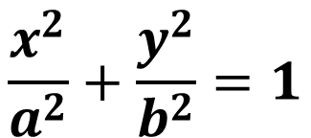













Ellipses Centered at $(0,0)$
$$b$$
$$\frac{x^{2}}{a^{2}}+\frac{y^{2}}{b^{2}}=1$$
$$c$$
$$b$$
$$−c$$
$$c$$
$$a$$
$$−a$$
$$−a$$
$$a$$
If $a$ is bigger, horizontal major axis.
If $b$ is bigger, vertical major axis.
Foci: Horizontal: $c^{2}=a^{2}−b^{2}$. Vertical: $c^{2}=b^{2}−a^{2}$.
$$−c$$
$$−b$$
ALWAYS POSITIVE!
$$−b$$
Ex) Graph the ellipse $\frac{x^{2}}{9}+\frac{y^{2}}{4}=1$.
Ex) Graph the ellipse $\frac{x^{2}}{9}+\frac{y^{2}}{36}=1$.

Slide 4

Ellipses Centered at $(0,0)$
$$b$$
$$\frac{x^{2}}{a^{2}}+\frac{y^{2}}{b^{2}}=1$$
$$c$$
$$b$$
$$−c$$
$$c$$
$$a$$
$$−a$$
$$−a$$
$$a$$
If $a$ is bigger, horizontal major axis.
If $b$ is bigger, vertical major axis.
Foci: Horizontal: $c^{2}=a^{2}−b^{2}$. Vertical: $c^{2}=b^{2}−a^{2}$.
$$−c$$
$$−b$$
ALWAYS POSITIVE!
$$−b$$
Ex) Find the standard form of the equation of an
Ellipse with vertices $(0,±6)$ and foci $(0,±5)$.
Ex) Graph the ellipse $\frac{x^{2}}{9}+\frac{y^{2}}{36}=1$.

Slide 5



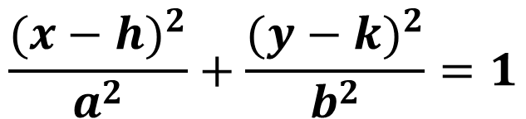





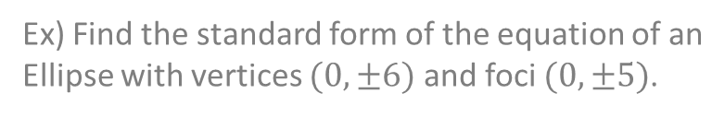








Ellipses Centered at $(h,k)$
$$b$$
$$\frac{{(x−h)}^{2}}{a^{2}}+\frac{{(y−k)}^{2}}{b^{2}}=1$$
$$c$$
$$b$$
$$−a$$
$$(h,k)$$
$$a$$
$$−c$$
$$(h,k)$$
$$c$$
$$a$$
$$−a$$
If $a$ is bigger, horizontal major axis.
If $b$ is bigger, vertical major axis.
Foci: Horizontal: $c^{2}=a^{2}−b^{2}$. Vertical: $c^{2}=b^{2}−a^{2}$.
$$−c$$
$$−b$$
$$−b$$
ALWAYS POSITIVE!
Ex) Find the standard form of the equation of an
Ellipse with vertices $(0,±6)$ and foci $(0,±5)$.
Ex) Find an equation of the ellipse that has center
$\left(2,5\right)$, a focus at $\left(−2,5\right)$, and a vertex and $\left(7,5\right)$.

Slide 6
What happens when the foci coincide?
The further the foci move from the center, the more elliptical the shape.
The closer the foci are from the center, the more circular the shape.
Center

